Slide 1
TOPIC A1:
COMPUTER FUNDAMENTALS
LESSON A1-4
DATA REPRESENTATION

Slide 2
AGENDA
Binary and Bytes
Binary to decimal
Hexadecimal
Binary and hex in nibbles
Storing characters: ASCII and Unicode
Storing images, audio and video
WS A1-1: Data Conversions
WHAT U NEED 4 LESSON
Guided Notes
ur hedz

Slide 3
THE WARM UP QUESTION
(a) State one difference between lossy and lossless compression.
(b) Your PA A1-2 took the bitmap from 176 characters to 91. Calculate the compression ratio, to two decimal places.
(c) The row WBWBWBWBWBWBWBWB encodes to 32 characters. State what this shows about run-length encoding.
-> Notes Q1 (a)-(c) [3 marks] - do them now

Slide 4
THE WARM UP ANSWER
(a) Lossless rebuilds the original exactly; lossy discards data permanently
(b) 176 / 91 = 1.93 : 1
(c) With short runs it makes the file bigger, so a saving is never guaranteed

Slide 5
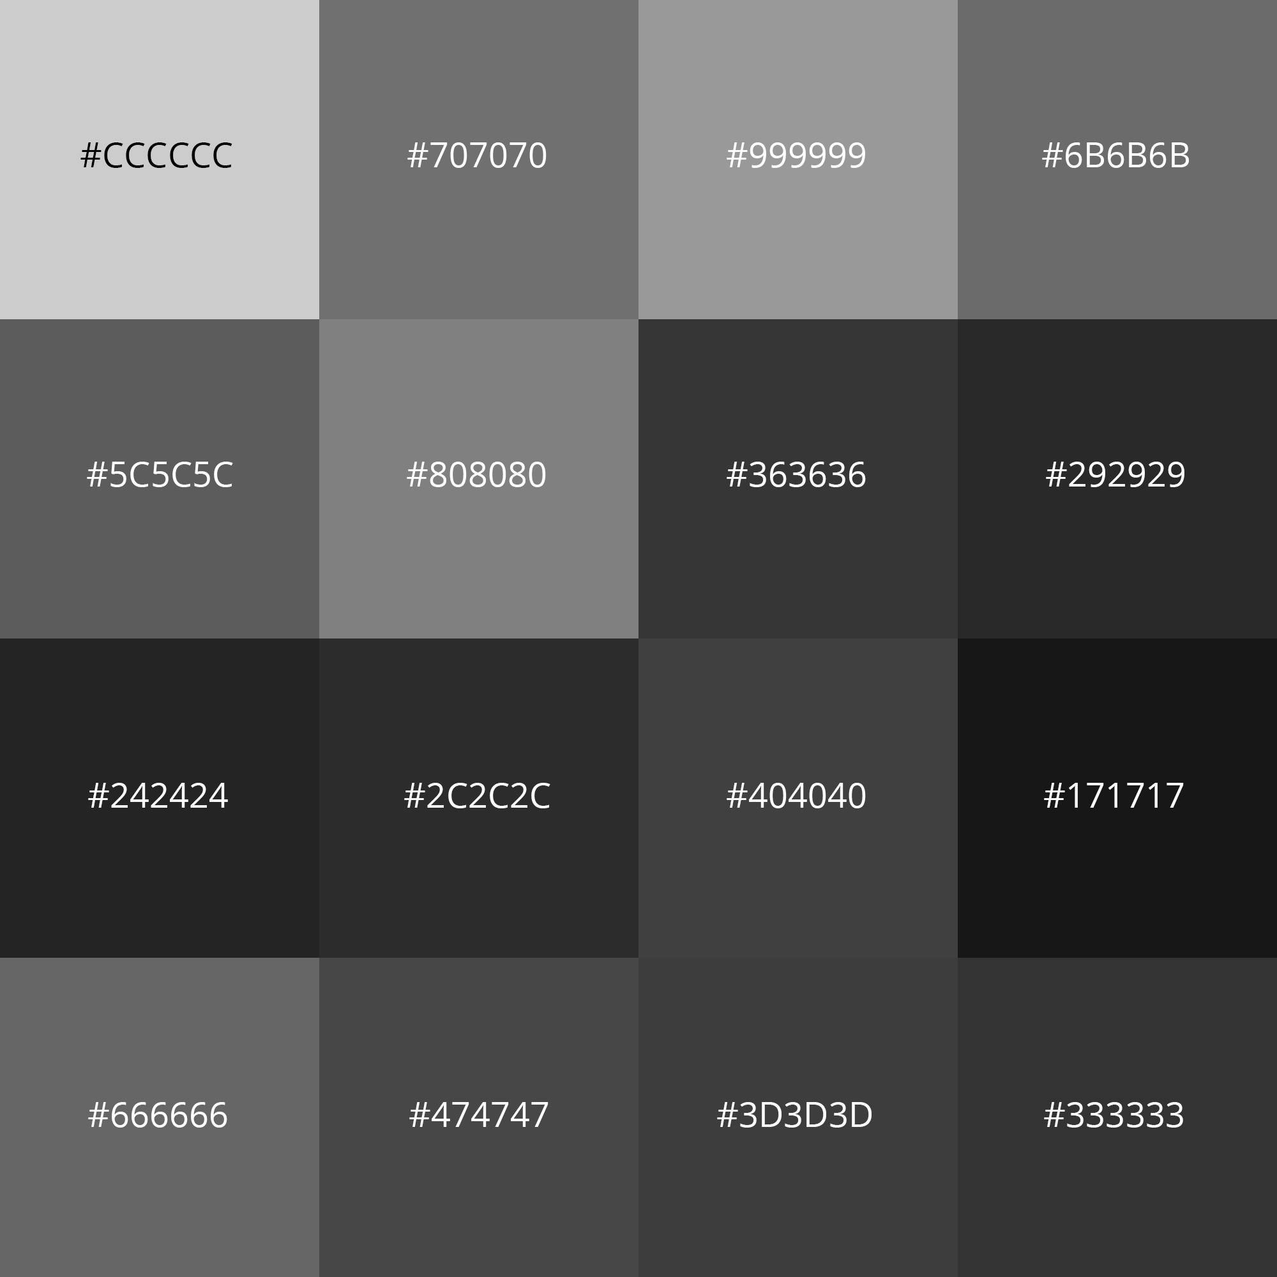
WHY BINARY?
A bit is one digit that can only be 0 or 1.
A transistor is either conducting or it is not. A capacitor is charged or it is not. A pit on a disc either reflects or it does not
Two states are easy to build, easy to detect, and hard to confuse
Think about how much easier it is to tell the difference between black and white than it is 10 shades of grey
Ten states would need ten reliably distinguishable voltage levels, which takes a lot of overhead to build
Binary is the thing that makes the hardware possible at all, not a limitation

Slide 6

BITS, BYTES AND NIBBLES
1 bit - a single 0 or one 1
4 bits = 1 nibble (how cute)
8 bits = 1 byte - the standard unit of storage
One byte has 2^8 = 256 possible patterns, so it can hold 0 to 255
Every capacity you have ever seen is bytes: KB, MB, GB, TB
-> Notes Q2 (a)-(c) - do them now

Slide 7
PLACE VALUE
In decimal, 4 0 7 means four hundreds, no tens, seven ones. Each column is ten times the one to its right.
Binary is the same idea with a smaller base. Each column is twice the one to its right (2^{n}) with n being the position from the left:
100 | 10 | 1
4 | 0 | 7
128 | 64 | 32 | 16 | 8 | 4 | 2 | 1

Slide 8
BINARY TO DECIMAL
Write the place values above the bits. Add up the columns holding a 1.
0110 1010
128 -> 0
64 -> 1
32 -> 1
16 -> 0
8 -> 1
4 -> 0
2 -> 1
1 -> 0
64 + 32 + 8 + 2 = 106
0110 1010 is 106
128 | 64 | 32 | 16 | 8 | 4 | 2 | 1
0 | 1 | 1 | 0 | 1 | 0 | 1 | 0

Slide 9
TWO MORE, SAME TABLE
Answer both of these with me
1111 0100 -> ???
0000 1111 -> ???
128 | 64 | 32 | 16 | 8 | 4 | 2 | 1

Slide 10
TWO MORE, SAME TABLE
Answer both of these with me
1111 0100 -> 128 + 64 + 32 + 16 + 4 = 244
0000 1111 -> 8 + 4 + 2 + 1 = 15
1111 1111 is 128 + 64 + 32 + 16 + 8 + 4 + 2 + 1 = 255 - the largest possible byte value
128 | 64 | 32 | 16 | 8 | 4 | 2 | 1

Slide 11
BINARY TO DECIMAL
-> Notes Q3 (a)-(c) - do them now
Q3 (a) 1011 0010
Q3 (b) 0011 1111
Q3 (c) 1000 0001

Slide 12
DECIMAL TO BINARY
Same table, read a different way. Go left to right and decide if the remaining values are smaller or equal than the current value
Value is smaller or equal -> write 1, subtract it from the initial number
Value is larger -> write 0, continue
Stop when nothing is left, then pad the rest with zeros to fill eight bits.
128 | 64 | 32 | 16 | 8 | 4 | 2 | 1

Slide 13
DECIMAL TO BINARY: 173
128 fits in 173 -> 1 (45 left)
64 does not fit -> 0
32 fits in 45 -> 1 (13 left)
16 does not fit -> 0
8 fits in 13 -> 1 ( 5 left)
4 fits in 5 -> 1 ( 1 left)
2 does not fit -> 0
1 fits in 1 -> 1 ( 0 left)
Answer: 1010 1101
You can check by adding the columns back: 128 + 32 + 8 + 4 + 1 = 173.
128 | 64 | 32 | 16 | 8 | 4 | 2 | 1
1 | 0 | 1 | 0 | 1 | 1 | 0 | 1

Slide 14
DECIMAL TO BINARY
-> Notes Q4 (a)-(c) - do them now
Q4 (a) 20
Q4 (b) 100
Q4 (c) 201
Ensure you include eight bits every time, leading zeros included.
If you need to, check by adding the columns back. It costs five seconds and catches everything.

Slide 15
HEXADECIMAL
Hexadecimal is base 16.
Sixteen digits, so the six after 9 are letters instead of traditional digits
0 1 2 3 4 5 6 7 8 9 A=10 B=11 C=12 D=13 E=14 F=15
Place values are powers of 16: the right-hand column is ones, the next is sixteens, 16^{n}, so on and so forth
So 3A is (3 x 16) + 10 = 58,
FF is (15 x 16) + 15 = 255 - the same largest byte as before.
128 | 64 | 32 | 16 | 8 | 256 | 16 | 1
1 | 0 | 1 | 0 | 1 | 1 | 0 | 1

Slide 16

WHY BOTHER WITH HEX?
Because 1101011010110110 is nearly impossible to read compared to D6B6
Two hex digits describe exactly one byte, making it convenient to map
You may even already be familiar with hexadecimal in colors: #FF0000 is a colour in hex - red FF, green 00, blue 00
MAC addresses, memory addresses, error codes, and hex dumps are also in hexadecimal

Slide 17
HEX AND DECIMAL
Hex to decimal: multiply the left digit by 16, add the right digit
8B -> (8 x 16) + 11 = 139
Decimal to hex: divide by 16. The whole number is the left digit; the remainder is the right
150 -> 150 / 16 = 9 remainder 6 -> 96
These only work for values that are a byte or less
How would it work if I needed to convert a 3 digit hexadecimal number?

Slide 18
HEXADECIMAL
-> Notes Q5 (a)-(e) - do them now
Q5 (a) State why hexadecimal is used rather than long strings of binary. [1]
Q5 (b) Convert 2F to decimal. [1]
Q5 (c) Convert BD to decimal. [1]
Q5 (d) Convert 76 to hexadecimal. [1]
Q5 (e) Convert 250 to hexadecimal. [1]

Slide 19

NIBBLES: THE SHORTCUT
One hex digit is exactly four bits, or one nibble
To go from binary to hex: split the byte down the middle and convert each half.
1010 1110 -> A E -> AE
To go the other way, expand each hex digit into four bits.
This is much easier than using decimal as an intermediary
decimal
hexadecimal
binary

Slide 20
ALL SIXTEEN NIBBLES
0 = 0000 8 = 1000
1 = 0001 9 = 1001
2 = 0010 A = 1010
3 = 0011 B = 1011
4 = 0100 C = 1100
5 = 0101 D = 1101
6 = 0110 E = 1110
7 = 0111 F = 1111

Slide 21
BINARY AND HEX: YOUR NOTES
-> Notes Q6 (a)-(d) [4 marks] - do them now
Q6 (a) Convert 1101 0110 to hexadecimal. [1]
Q6 (b) Convert 0010 1011 to hexadecimal. [1]
Q6 (c) Convert A7 to binary. [1]
Q6 (d) Convert 3E to binary. [1]

Slide 22
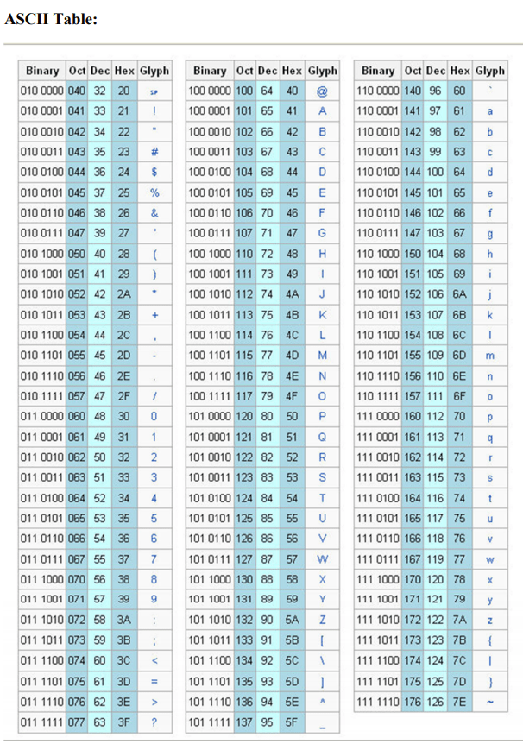
SO WHAT IS ACTUALLY IN A FILE?
Everything so far has been integers, but images don’t come in integers, nor do songs
We agree on a standard of what the numbers mean, then store the numbers.
That agreement is called a character set when the data is text.
ASCII – a text encoding scheme with 7 bits, 128 characters
Includes letters, digits, punctuation, and some control codes
A = 65, B = 66, a = 97, 0 = 48, space = 32

Slide 23
UNICODE
ASCII has 128 slots, which is great if you only speak English, but that wouldn’t be very IB of us.
Unicode gives every character in every script its own number - over 150,000 of them, and it has room for far more
UTF-8 is the common encoding of it: one byte for anything in ASCII, up to four for everything else
The first 128 Unicode characters are the ASCII ones, with the same numbers, making it backwards compatible
An emoji is a Unicode character. It is a number, like every other character.

Slide 24
THE WORD "PIG", THREE WAYS
Three characters, three bytes
Every character is exactly two hex digits, because every one of them is exactly one byte.
Changing any data changes the message
This is why we can’t use lossy encoding on text, generally
ASCII Character | Decimal | Hex | Binary
P | 80 | 50 | 0101 0000
I | 78 | 49 | 0100 1001
G | 71 | 47 | 0100 0111

Slide 25
CHARACTERS
-> Notes Q7 (a)-(c) [3 marks] - do them now
Q7 (a) The ASCII code for A is 65. State the ASCII code for D. [1]
Q7 (b) State one reason Unicode was needed when ASCII already existed. [1]
Q7 (c) A string of 12 characters is stored in ASCII, one byte per character. Calculate the number of bits used. [1]

Slide 26
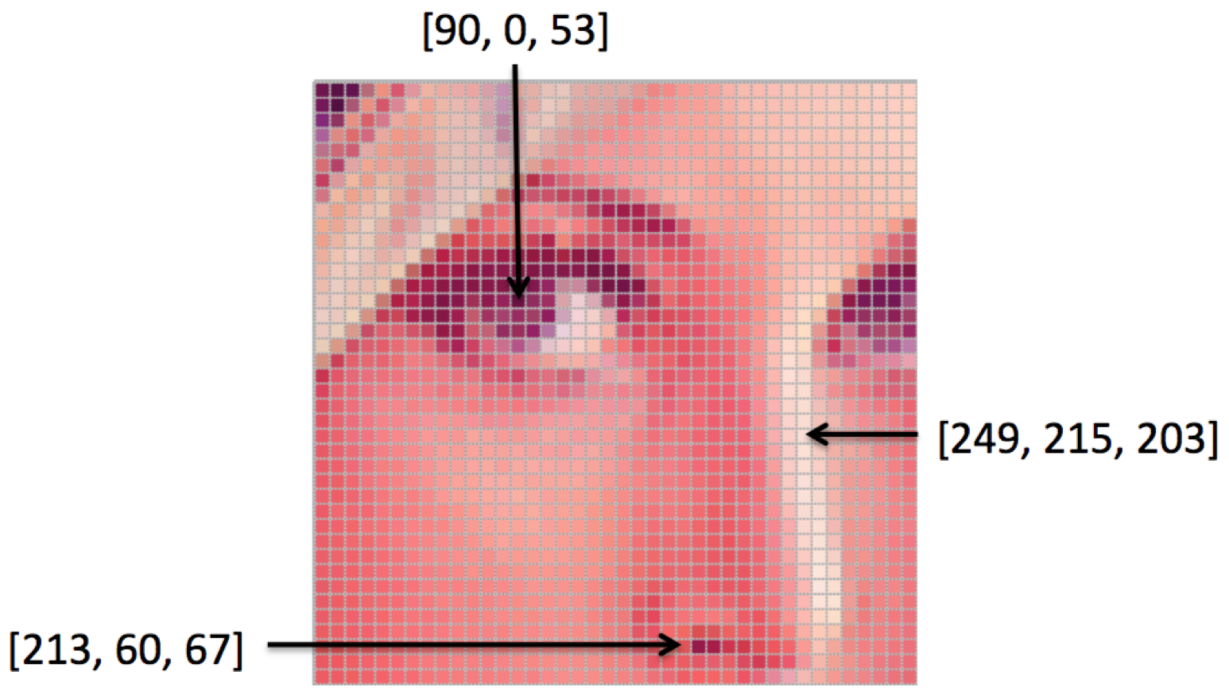
IMAGES IN BINARY
A pixel is one dot
Its color is a number, so a picture is a grid of numbers.
Resolution is how many pixels: 1920 x 1080 is about two million of them
Bit depth is how many bits each pixel gets. 1 bit gives two colours, 8 bits gives 256, 24 bits gives about 16.7 million

Slide 27
IMAGES IN BINARY
The A1-3 bitmap was 1 bit per pixel: W became 0, B became 1, and 176 pixels fit in 22 bytes
the same 176 pixels at 8 bits each = 176 bytes
the same 176 pixels at 24 bits each = 528 bytes
It’s worth noting that real image files also carry metadata - dimensions, color model, camera, date

Slide 28
AUDIO IN BINARY
Sound is a continuous wave. Binary is not continuous, so we measure the wave thousands of times a second and store the measurements.
Sample rate - how many measurements per second
A CD uses 44,100
Bit depth again - how precisely each measurement is stored
A CD uses 16 bits
More of either means a closer match to the original wave, and a bigger file
This is the raw data that MP3's transform coding, from the last lesson, goes to work on

Slide 29
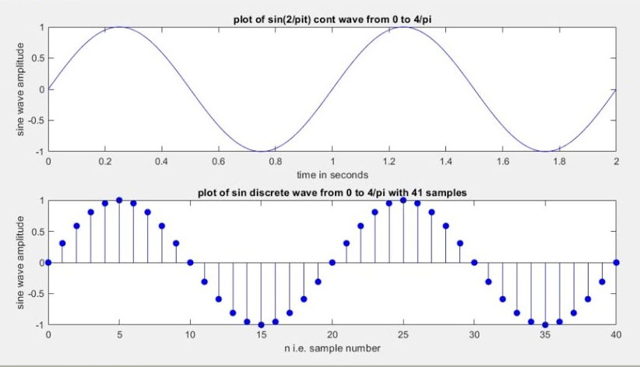
AUDIO IN BINARY

Slide 30
VIDEO, AND THE SIZE PROBLEM
Video is images plus audio plus a frame rate
One second of 1080p at 30 fps is thirty full images
One 1080p frame at 24 bpp = 6,220,800 bytes
Ten seconds at 30 fps = about 1.87 GB
Obviously, this doesn’t work for streaming, so we effectively have to use lossy compression on video files

Slide 31
STORAGE
-> Notes Q8 (a)-(c)
Q8 (a) Your A1-3 bitmap used one bit per pixel. State how many colours that allows. [1]
Q8 (b) An image is 100 x 200 pixels at 3 bytes per pixel. Calculate the file size in kilobytes, ignoring metadata. [1]
Q8 (c) Audio is sampled 44,100 times per second at 16 bits per sample, in mono. Calculate the number of bits stored for one second. [1]

Slide 32
LAB
-> Notes Q9, Q10 and Q11
Q9 Explain why computers use binary rather than decimal to store data. [3]
Q10 Explain how a black-and-white bitmap image, like the one in PA A1-2, is stored in binary. Refer to pixels, bit depth and resolution. [3]
Q11 A 3-byte file contains the hexadecimal values 48 69 21. Using ASCII (H = 72, i = 105, ! = 33), determine the text stored in the file. [2]

Slide 33
LAB ANSWERS
Q9 Two states are cheap and reliable to build and detect; more states would need many distinguishable voltage levels; every value can be encoded in 0s and 1s
Q10 One bit per pixel, so two colors; the resolution gives the number of pixels; the bits are stored in reading order and the dimensions come from the metadata
Q11 48 = 72 = H, 69 = 105 = i, 21 = 33 = ! -> "Hi!"

Slide 34
WS A1-1: DATA CONVERSIONS
Five sections, 30 marks
Try NOT to use a calculator
Sections A to D [22] - binary, decimal and hex conversions, both directions
Section E [8] - four applied questions on how real files are sized

Slide 35

VOCABULARY TO REMEMBER
Bit
Nibble
Byte
Binary
Hexadecimal
Place value
Character set
ASCII
Unicode
UTF-8
Pixel
Resolution
Bit depth
Sample rate
Metadata
Frame rate

